Slide 1
AI-Driven Document Intelligence with Semantic Retrieval and Controlled LLM Integration
Chathurya V
Sathwik Vintha

Slide 2
Agenda
Problem Statement
Tech Stack
Proposed Solution
Advantages and Disadvantages
Improvement Measure
Maintenance and Packaging

Slide 3
Problem Statement
As fresher/ new lateral Hire, we found it difficult to understand and navigate large technical documents without external help.
Manually searching through PDFs and configuration guides was time-consuming and inefficient.
Due to data security reasons, using online generic AI chatbots by uploading our project documents may not be a safe option.
Hence, there is a need for a reliable, document-grounded question-answering system that provides accurate and real-time responses directly from source documents.

Slide 4
Tech Stack
🔹 Frontend Chatbot
Angular – User Interface
TypeScript
HTML / CSS
🔹 Tools & Environment
Node.js
Git & GitHub
Python Virtual Environment (.venv)
🔹 Backend
Python
FastAPI – REST API framework (Web)
Uvicorn – ASGI server
🔹 Machine Learning
DistilBERT (Fine-tuned) – Extractive Question Answering
SentenceTransformers (all-MiniLM-L6-v2) – Text Embeddings
FAISS – Vector similarity search
Qwen 2.5 (via OpenRouter API) – Grounded LLM explanation layer
Used in 2 places (To generate QA to train DistilBERT, Used as last layer to generate answer)
PyTorch – Model training & inference

Slide 5
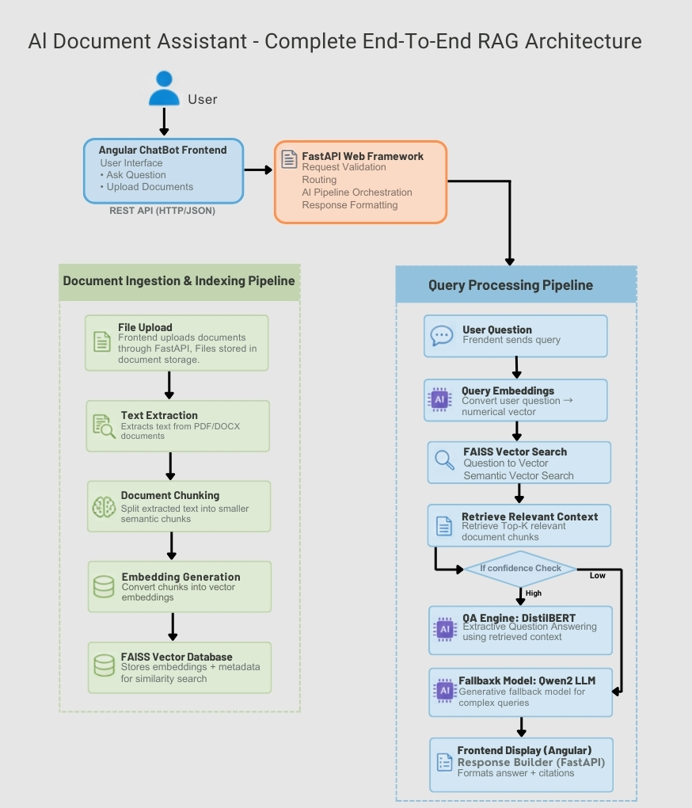
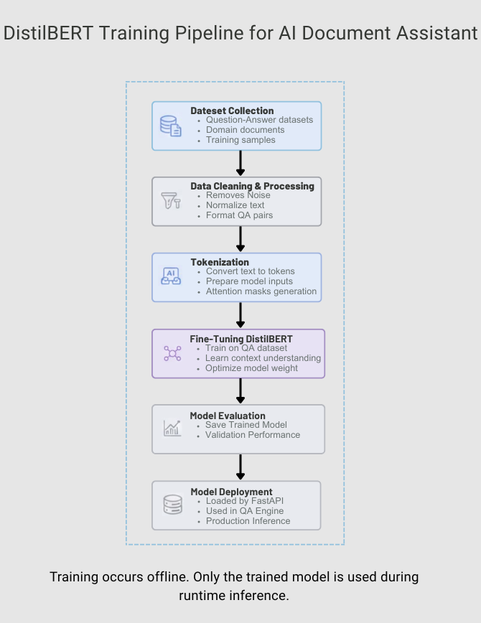
Proposed Solution

Slide 6
Advantages and Disadvantages
Advantages | Disadvanges
Fast information retrieval | Initial setup complexity
Document-grounded responses | Chunking limitations
Semantic search capability | Dependency on document quality
Improved productivity | Maintenance overhead

Slide 7
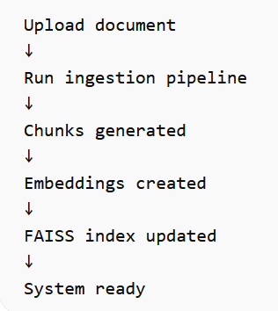
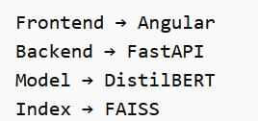
Maintenance and Packaging
Adding New Documents Maintenance
CHATBOT_DISTILBERT – Complete Project Documentation
Regular tasks:
• Upload new documents • Rebuild embeddings • Monitor API performance • Update model periodically
Deployment Packaging

Slide 8
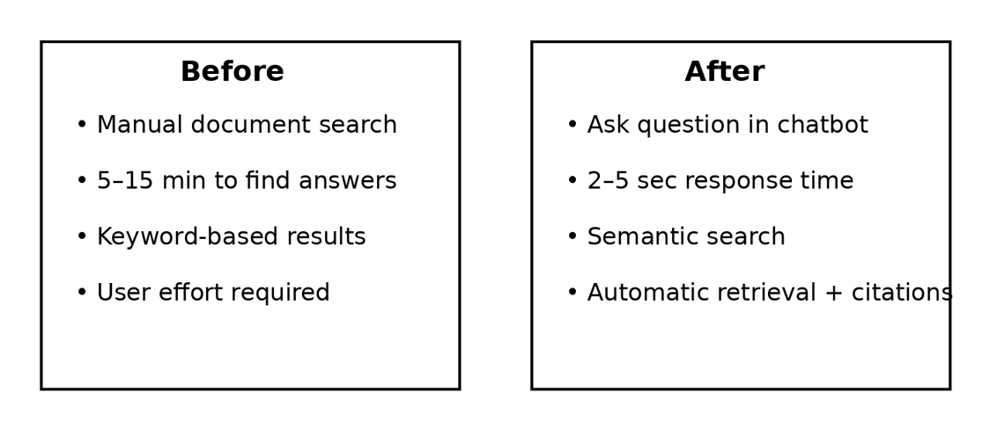
Improvement Measure
Performance Improvements After Implementing the AI Document Assistant
The AI assistant significantly reduces the time required to locate information across organizational documents.
Manual document search previously took 5–15 minutes.
The system now returns accurate answers in 2–5 seconds.
Semantic retrieval improves relevance and reduces user effort.
The system uses FAISS for intelligent search and DistilBERT to extract precise answers from documents.

Slide 9
Thank you

